Slide 1
Hereditary cancer, the next generation
Raymond Kim
MD/PhD, FRCPC, FCCMG, FACMG
Medical Geneticist
Princess Margaret Cancer Centre

Slide 2
Outline
Genetic terminology and concepts
Hereditary cancers
When to consider
Genetics assessment
Surveillance
Hereditary breast cancer syndromes
Hereditary colorectal cancer syndromes
Hereditary kidney cancer syndromes
Hereditary endocrine cancer syndromes
Genetic testing
Genetic counseling

Slide 3
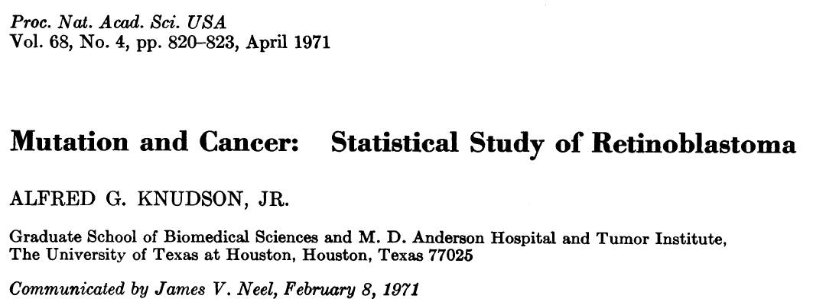
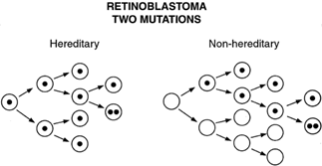
Cancer is a genetic disease
Notes:
This is a slide emphasizing the genetic basis of cancer with the knudson two hit hypothesis which arose from his study of retinoblastoma and how it applies to both sporadic or non-inherited forms of cancer.

Slide 4
Timing of the genetic change…
Sporadic cancer
Hereditary cancer
Majority of cancer patients (90%)
Genetic change occurs during life
Localized mutation detected in tumour “somatic”
Both hits in tumour, none in the blood
No pattern in family tree
Elderly to accumulate second hit
Minority of cancer patients (10%)
Born with genetic mutation
All cells in body carry mutation “germline” = first hit
Second hit observed in tumour
Family tree with a pattern
Unusual tumours
Multiple cancers in same individual
Young cancers
Notes:
All cancers are genetic, however the timing of the genetic change is important to distinguish if it is hereditary.

Slide 5
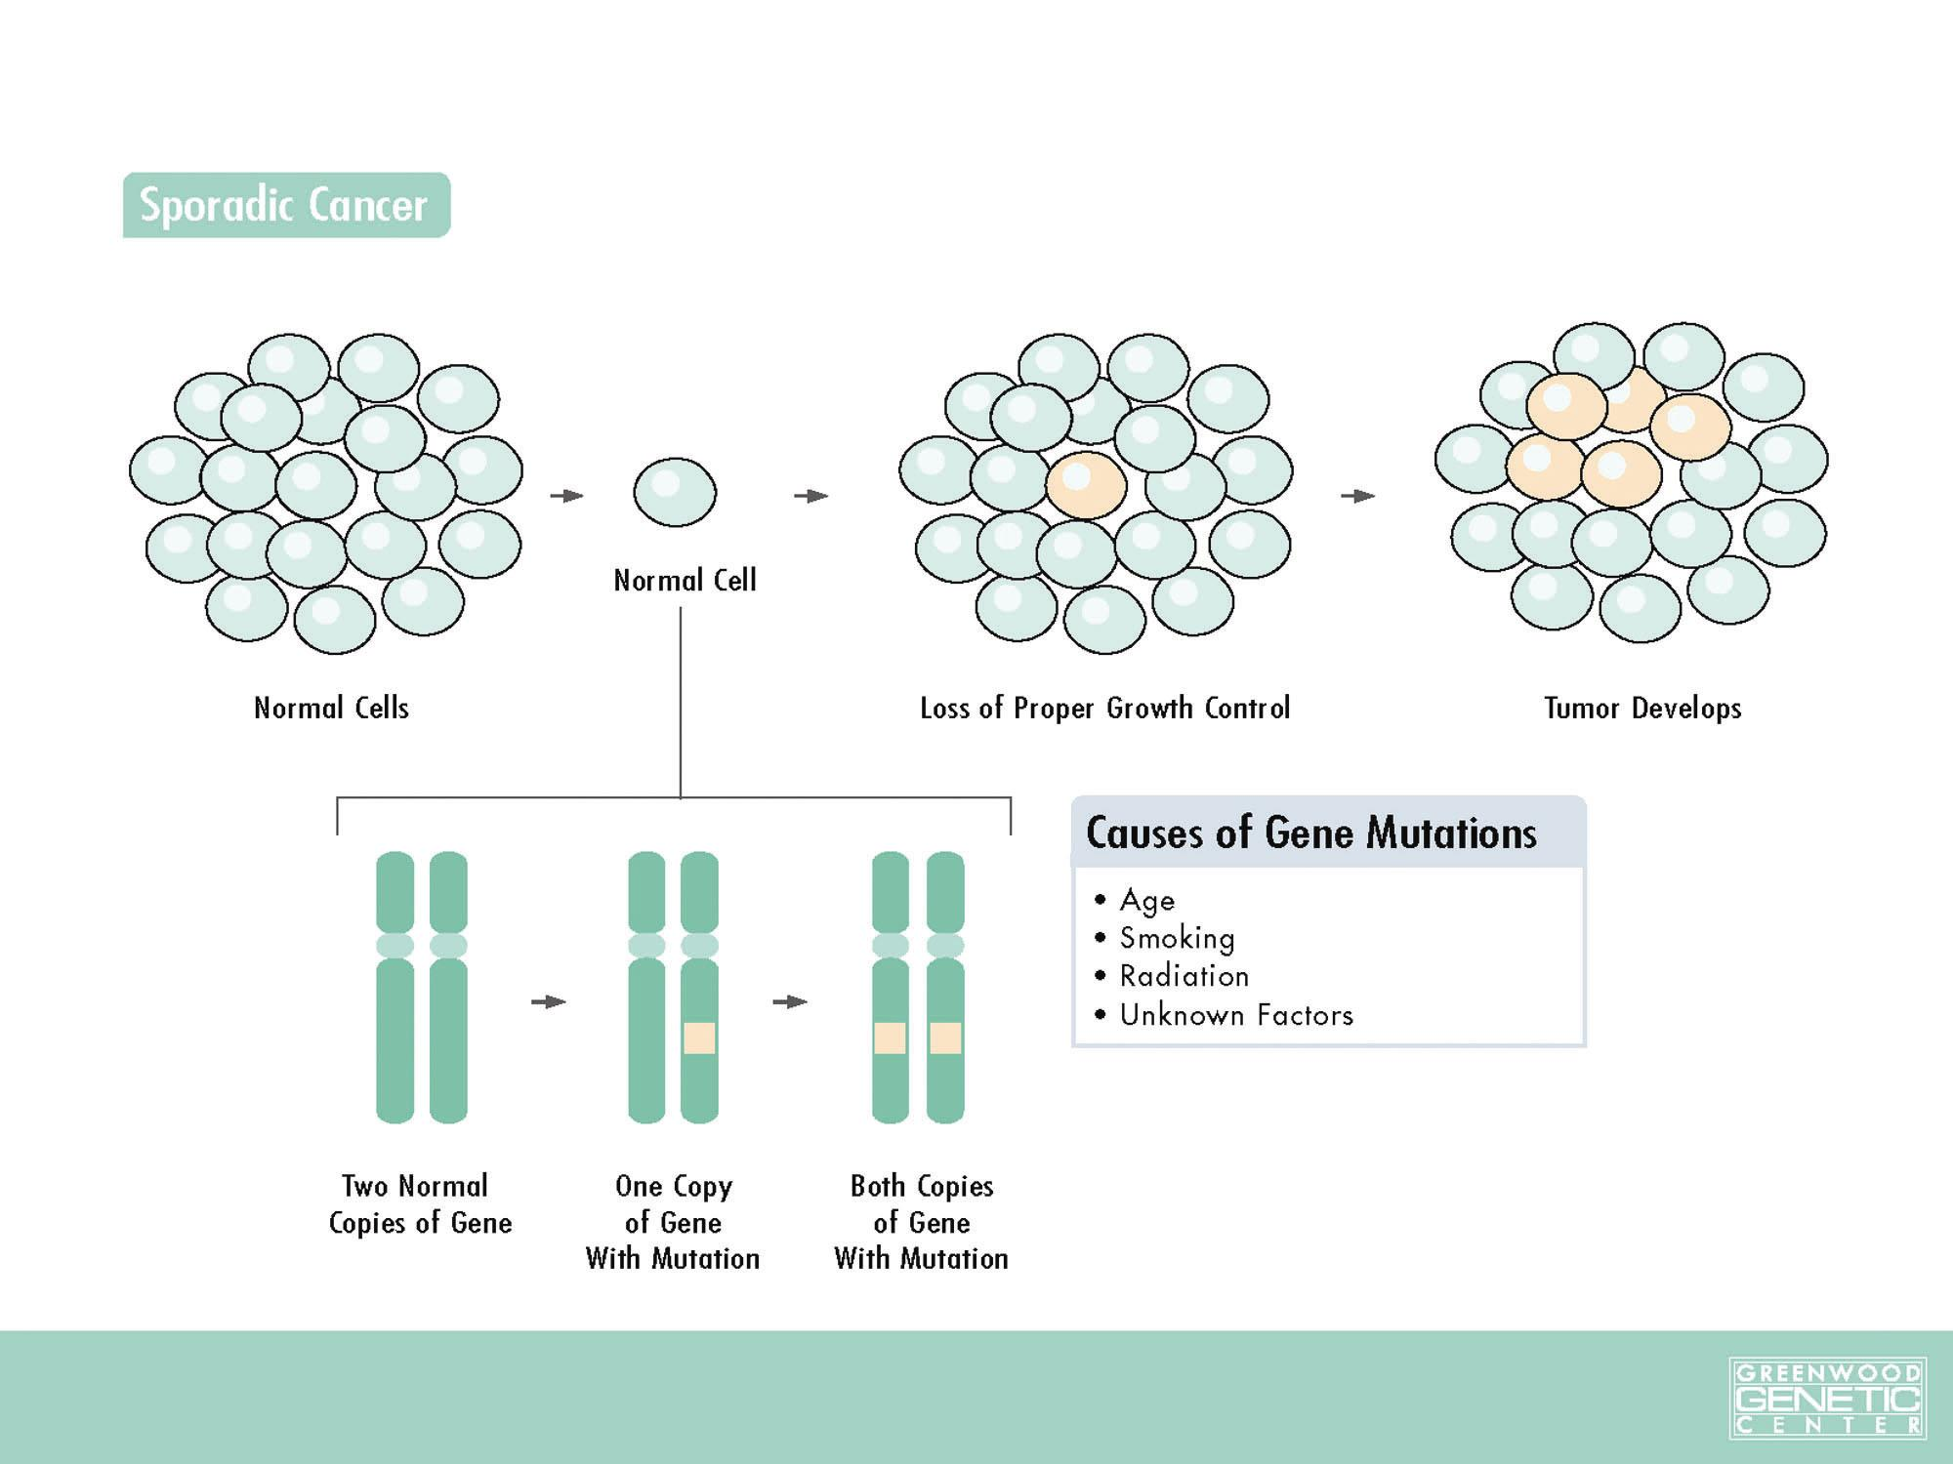
Key point: rest of body does not have the mutation,
sees an oncologist

Slide 6
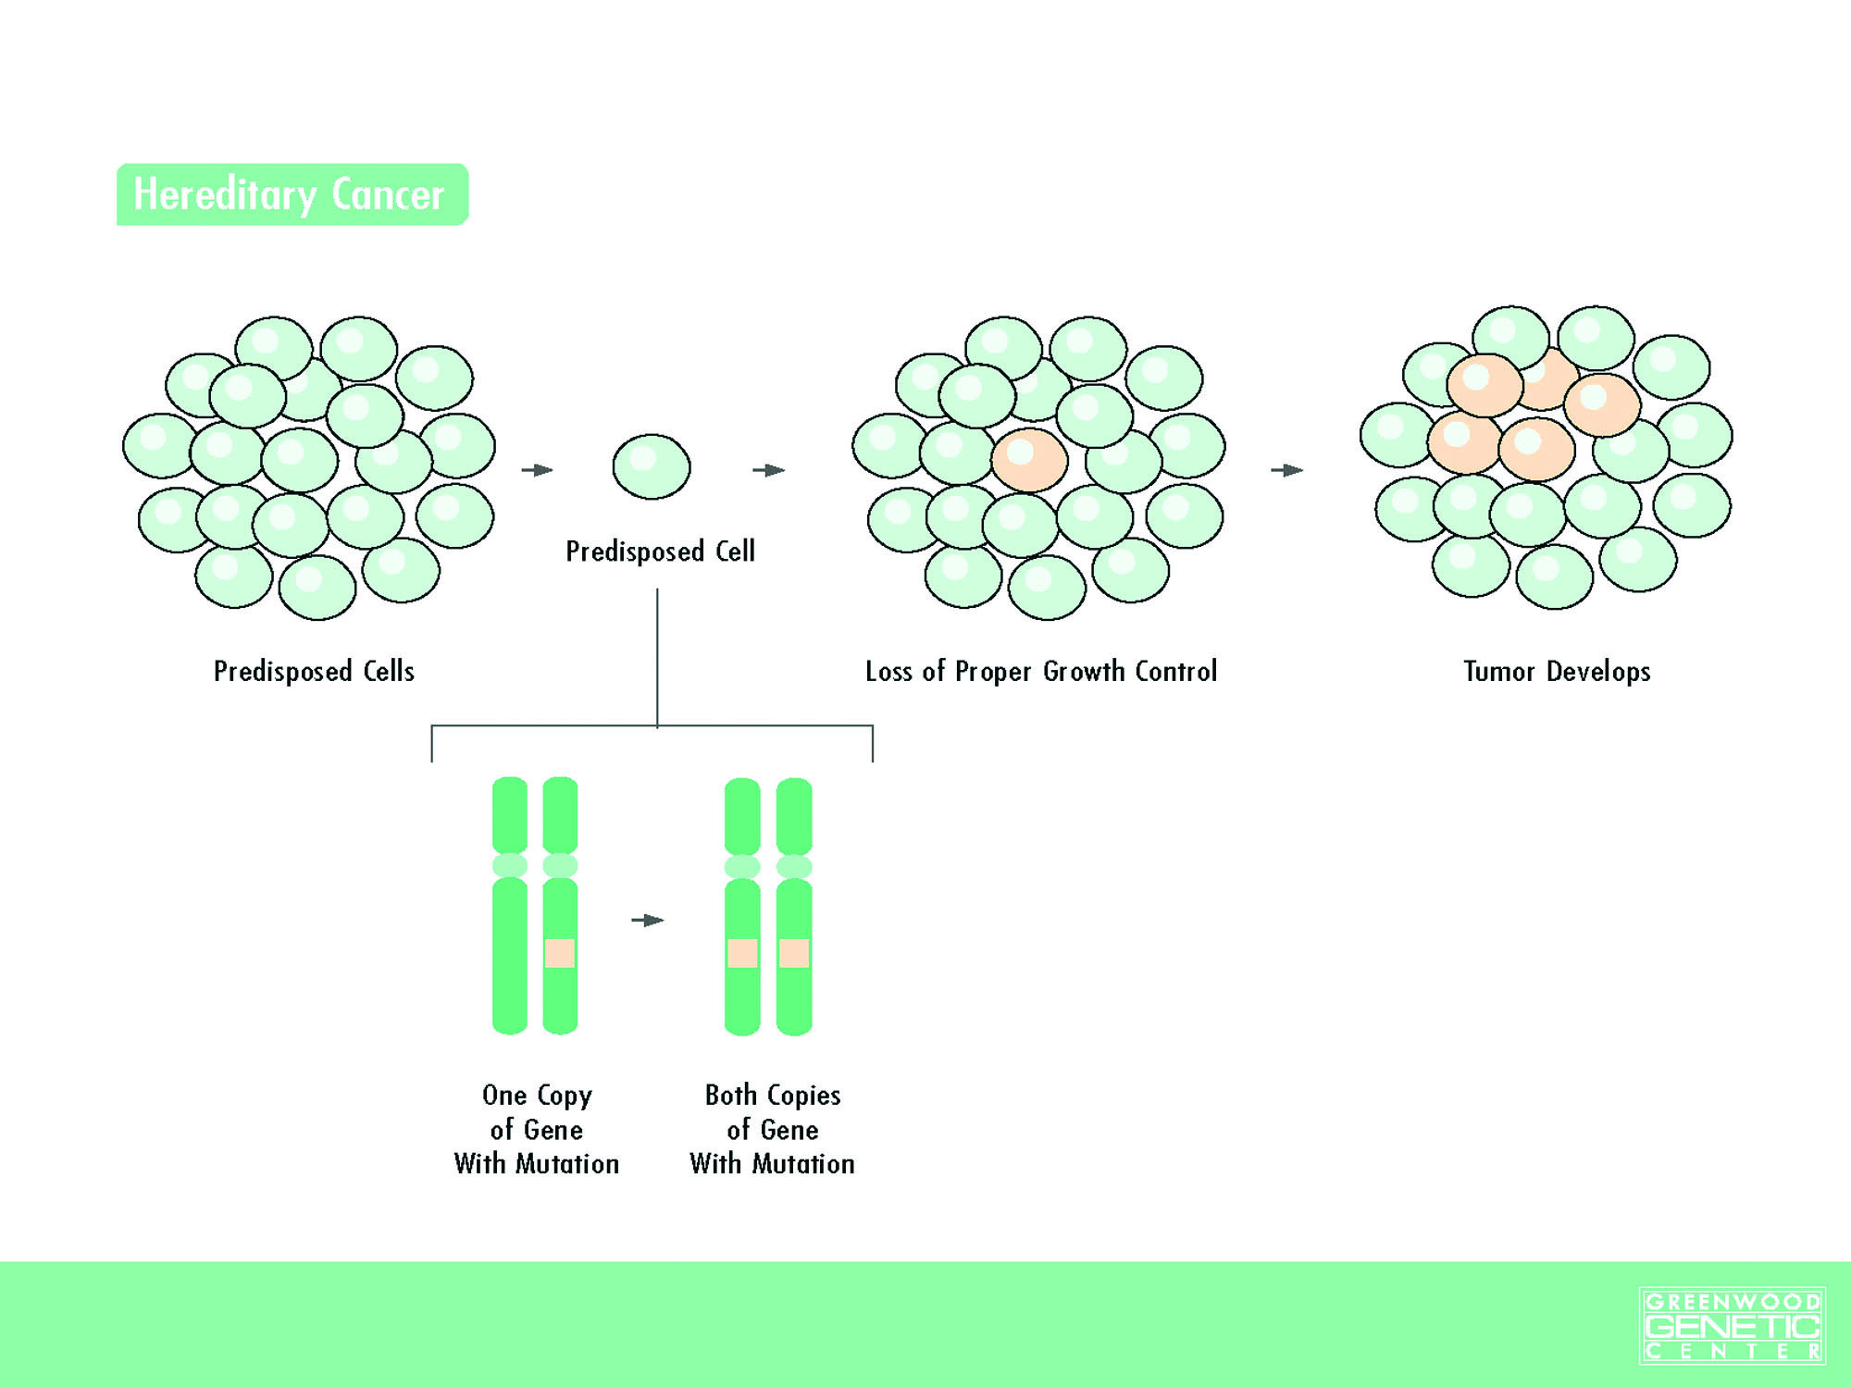
Key point: whole body has the mutation, sees a geneticist and oncologist

Slide 7
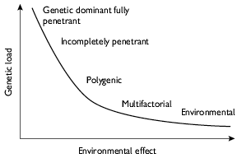
Who do medical geneticists see?
All diseases have a genetic component
Not all diseases require a medical genetics consultation
Continuum of genetic contribution
Many genes interacting with environment (multifactorial)
Coronary artery disease
Few genes interacting with environment (poly-genic)
Diabetes mellitus, IBD
Single gene interacting with environment (incomplete penetrance)
Hereditary cancer
Single gene (fully penetrant)
Huntington disease, Sickle cell anemia

Slide 8
Incomplete Penetrance
Penetrance is defined as the proportion of mutation carriers who harbour any manifestations of a disease
Hereditary cancer = high penetrance, but not complete penetrance
Mutation carriers are at high risk of developing malignancy
Some mutation carriers do not develop malignancy
BRCA1+
BRCA1+
BRCA1+
BRCA1+
BRCA1+
BRCA1+
BRCA1+
Ovarian
Breast
Ovarian

Slide 9
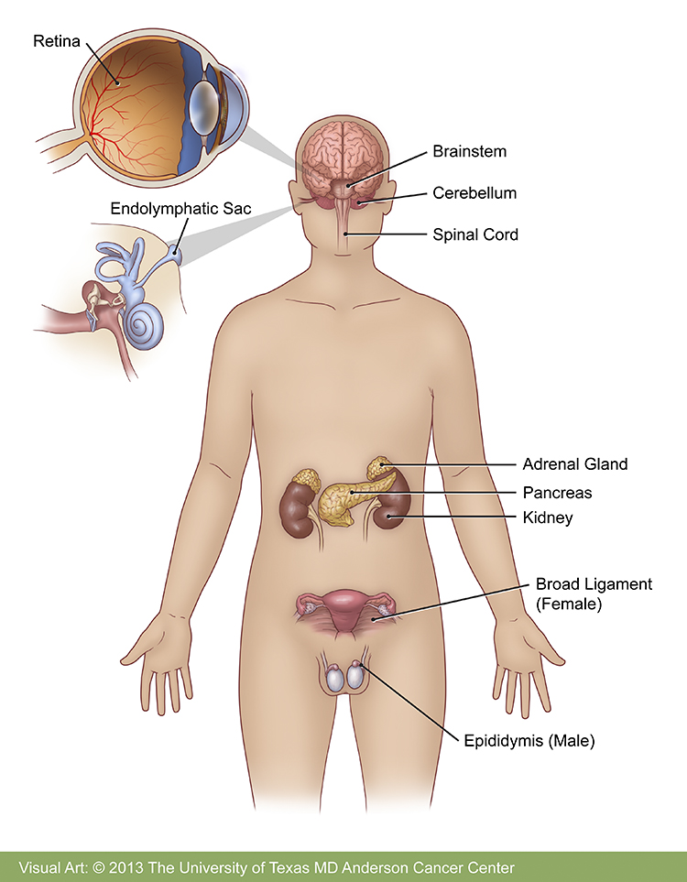
Variable Expressivity
Not all individuals with a mutation will develop the same manifestations
E.g. BRCA1 patient
Mom has ovarian cancer
Daughter has breast cancer
Von Hippel Lindau
Variety of systemic manifestations
Not all patients will have same organ involvement

Slide 10
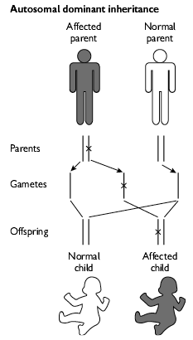
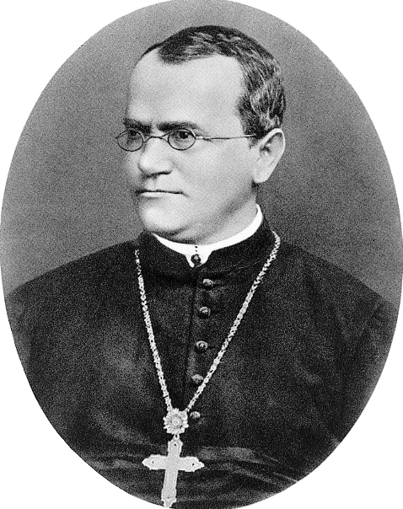
More genetics concepts
Hereditary cancer syndrome
Familial cancer
Mendelian cancer
Autosomal dominant (adult)
Autosomal recessive (pediatric)
Imprinted cancers

Slide 11
Chromosomes vs genes and inheritance
Autosomes
Chr 1-22
Sex
chromosomes

Slide 12
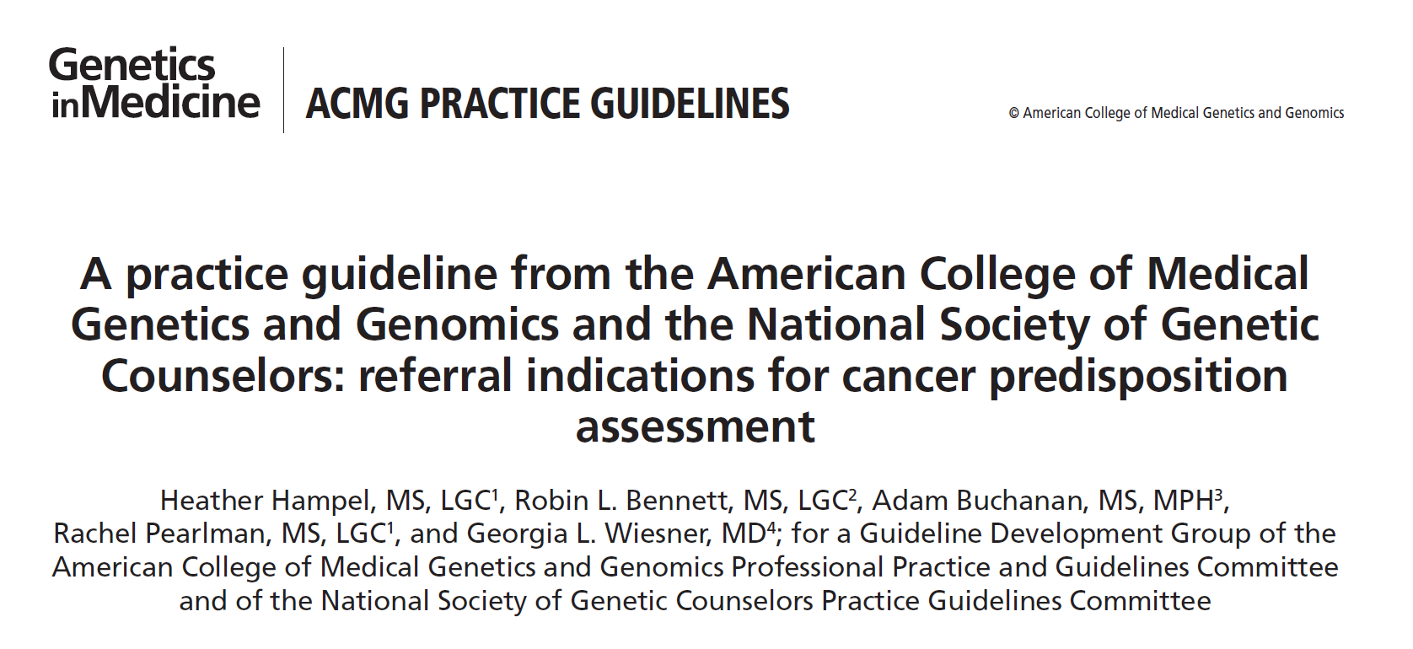
Hereditary cancer syndromes
Over 50 syndromes catalogue in 2008
Over 300 syndromes entered into OMIM (Online Mendelian Inheritance in Man)
Under-recognized and under-referred
Germline genetic testing results affect
Surveillance
Surgical management
Eligibility for trials
Distinct from somatic profiling of the tumour for targeted therapy (non-inherited changes in tumours)

Slide 13
Hereditary Breast and Ovarian Cancer
BRCA1
40-70% Breast (vs 12%)
20-40% Ovarian (vs 1.5%)
20-30% Prostate (vs 17%)
Surveillance
Breast MRI@25years
CA-125 and US not offered
Management
Mastectomy
Prophylactic Bilateral Salpingo-oopherectomy
Chemoprevention (tamoxifen)
PARP trials

Slide 14
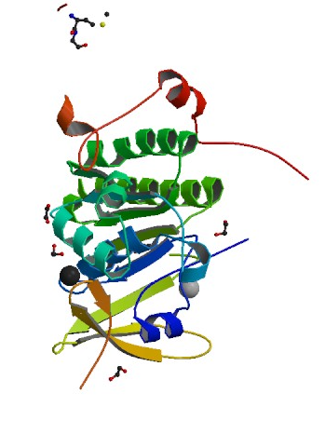
BRCA2
40-70% Breast cancer
10-20% Ovarian cancer
30-40% Prostate cancer
6% Male breast cancer (vs 0.1%)
3% Melanoma (vs 1%)
5% Pancreatic (vs 1%)
One mutation leads to hereditary breast and ovarian cancer
Two mutations lead to Fanconi Anemia, childhood recessive disorder

Slide 15
When to suspect BRCA1/2 in the medical oncology clinic?
Patient is from a BRCA1/2 family (need to ASK!)
Ethnicity: Ashkenazi Jewish
Bilateral breast cancer
Age: under 35
Male Breast cancer
Invasive Serous Ovarian cancer
Medullary breast cancer ~11% BRCA1
Triple negative breast cancer <60 (NCCN)
Strong family history of breast and ovarian cancer
Variety of criteria, depends on age and number of family members affected
Ontario Ministry of Health Guidelines
National Comprehensive Cancer Network Guidelines
Guidelines exist to have a diagnostic yield ~10%

Slide 16
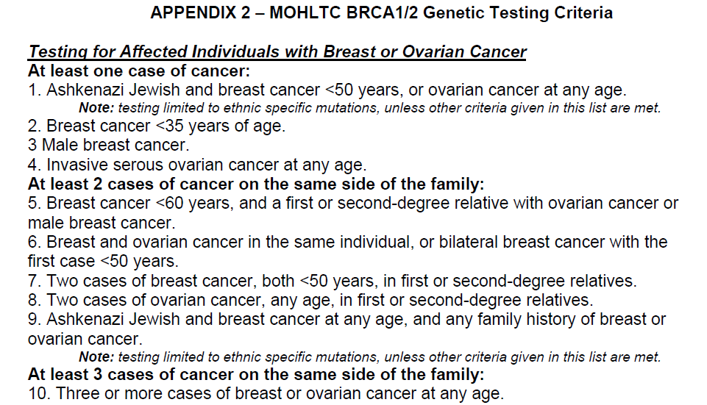
Notes:
Eg. Male breast cancer, ovarian cancer has more weight, and younger cancer have more weight

Slide 17
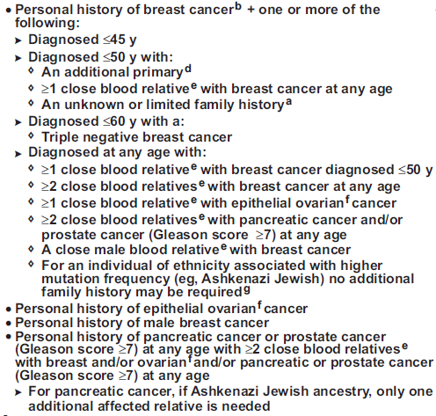
Notes:
NCCN is more liberal, as all breast <45, high gleason prostate cancer, pancreatic cancer, TNBC

Slide 18
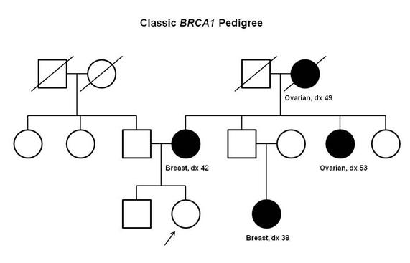
Who to test?
Medical Oncologists usually see patients with cancer
Patients affected with cancer are the most appropriate individuals to test to interpret the genetic results
If no family members, available, some high risk families can have testing on unaffected individuals if probability of mutation based on computer models >10%, but many limitations of this
Need to consider DNA banking on all individuals with cancer as new genes are discovered (panel testing)

Slide 19
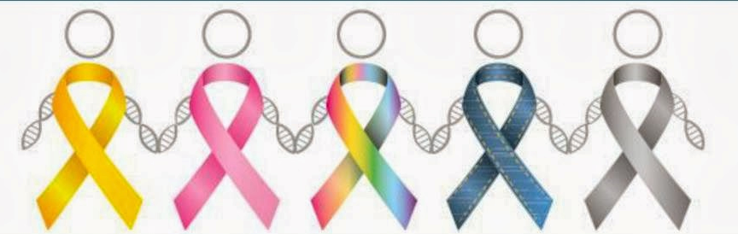
LiFraumeni Syndrome
TP53 germline mutations, tumour suppressor
Core cancers:
Brain
Choroid plexus carcinoma
Breast cancer
Sarcoma
Adrenocortical carcinoma
Bronchoalveolar cancer
GI malignancy
When to suspect:
Young breast cancer <35
Strong family history of core cancers
All adrenocortical carcinomas
All sarcomas <45 years

Slide 20
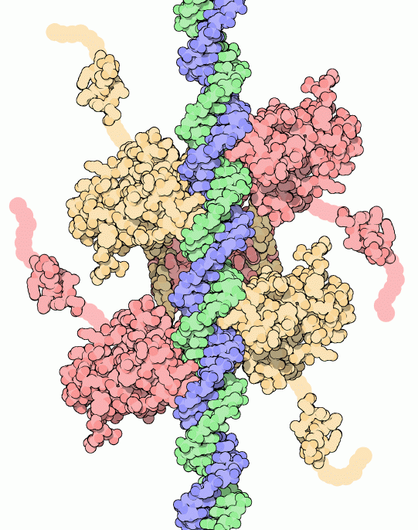
LiFraumeni surveillance
Risk of cancer in women 100%, men 75%
Risk reduction options include Bilateral mastectomy
Screening using the Toronto Protocol (Villani et al 2011)
Annual Breast MRI, beginning @ 20-25y
Annual Rapid whole body MRI (not CT)
Annual Brain MRI
q6m Abdominal US, CBC, LDH, ESR
Annual dermatology exam
q2y C-Scope, beginning @ 25y
Consideration of metformin for chemoprophylaxis
Done through Princess Margaret Familial Breast and Ovarian Cancer Clinic

Slide 21
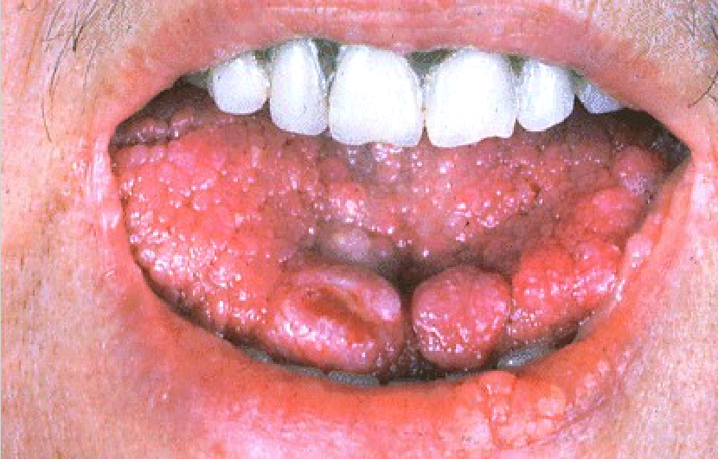
Cowden syndrome
Germline mutation in PTEN, PIK3CA, AKT1
Cancer risks
Breast cancer 85% lifetime risk
Thyroid disease in 75% of Cowden patients
Multinodular goitre
Epithelial thyroid cancer follicular>papillary
Endometrial Cancer
Colorectal Cancer
Physical features
Developmental Delay
Head circumference >59cm
Papillomas on skin and mucosa
Dysplastic gangliocytoma of cerebellum
Skin lesions such as acral keratoses

Slide 22
Surveillance in Cowden syndrome
Annual thyroid ultrasound from childhood
High risk Breast screening MRI/mammography @30
Colonoscopy @35, q5years
Renal ultrasound @40
Endometrial biopsy@30
Annual dermatologic exam
Conducted through Princess Margaret Familial Breast and Ovarian Cancer Clinic

Slide 23
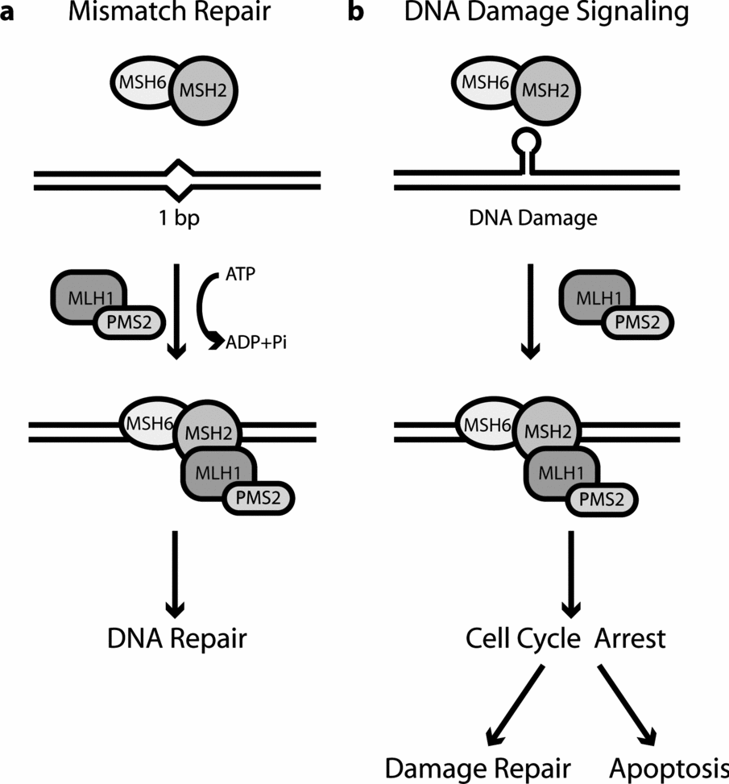
Lynch syndrome
Mismatch repair pathway deficiency
Colorectal cancer (50-80%)
Endometrial (25-60%)
Ovarian (5-10%)
Hepatobiliary (1-5%)
Adrenocortical carcinoma (3%)
MLH1, MSH2, MSH6, PMS2
Consider if:
Amsterdam criteria
3 individuals
2 first-degree relatives
1 under 50
CRC<35 years of age
CRC+another Lynch cancer
Other ongoing screening protocols
NCCN all CRC<70, UHN endometrial <70
Annual Colonoscopy ~25y, consider endometrial surveillance

Slide 24
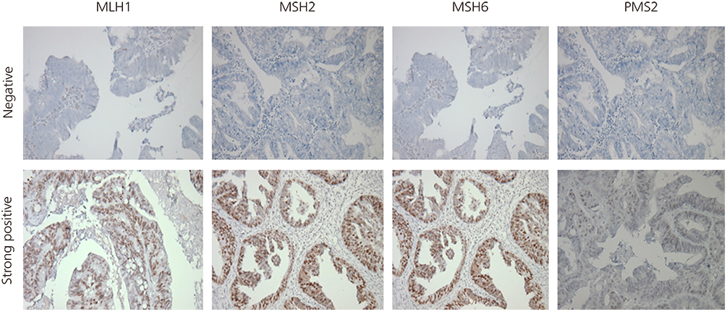
Immunohistochemistry in Lynch syndrome
abnormal
normal

Slide 25
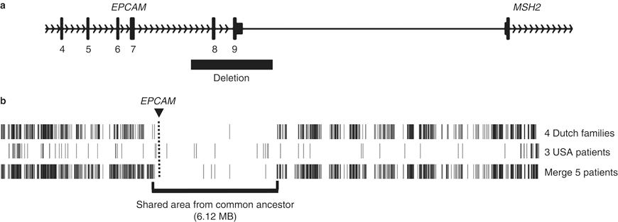
MSH2 loss of expression caused by upstream gene, EPCAM
Deletion of EPCAM gene causes methylation of MSH2 region preventing MSH2 expression, an epigenetic mechanism

Slide 26
Microsatellite Instability in Tumours with Lynch syndrome

Slide 27
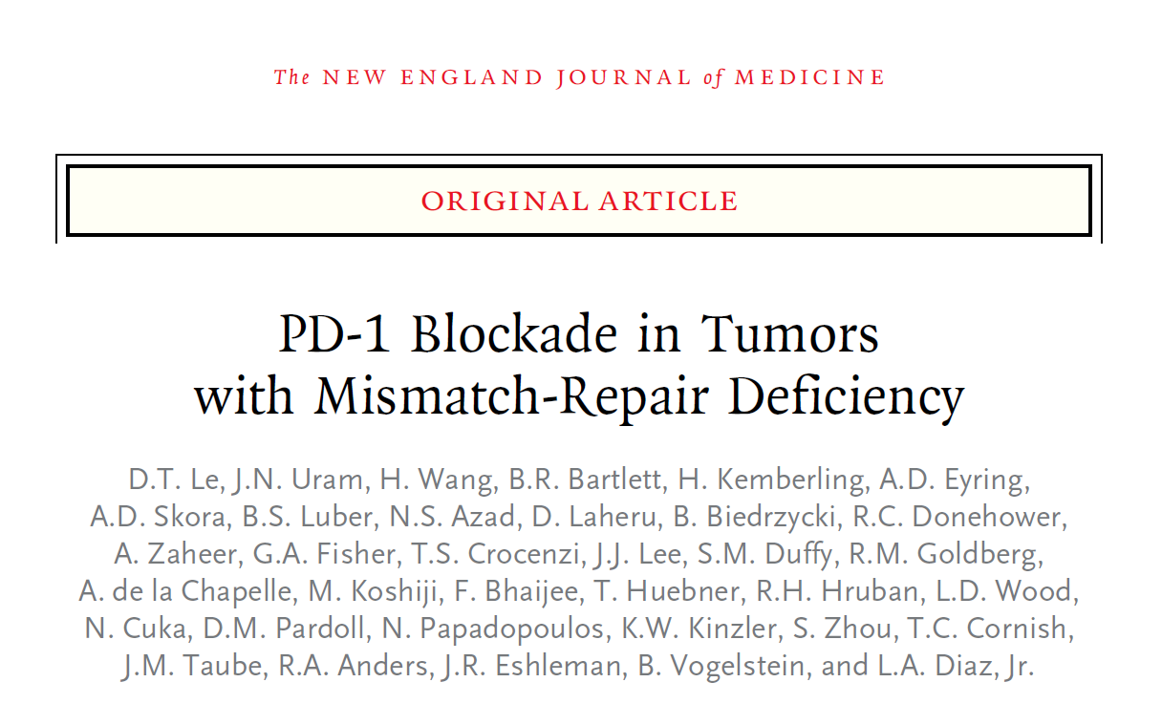

Slide 28
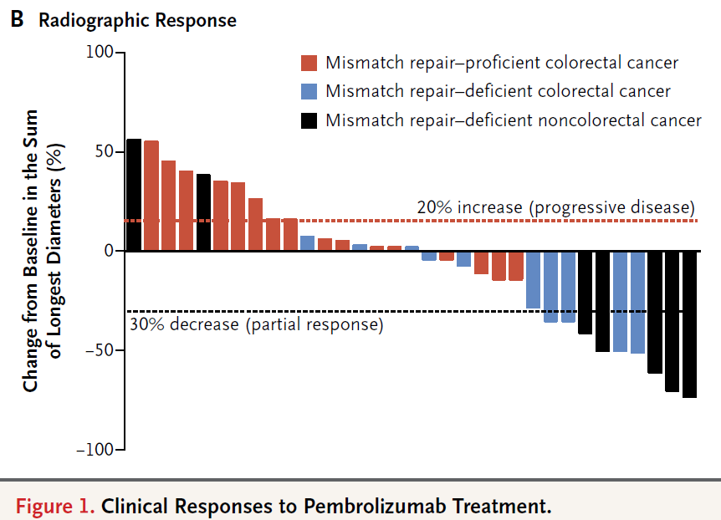
Mismatch repair deficient (Lynch and others) respond to PD-1 blockade
73 somatic mutations
1782 somatic mutations

Slide 29
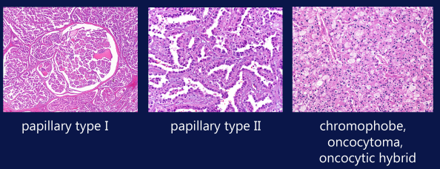
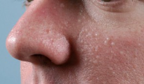
Hereditary kidney cancer, rare histologies could be hereditary
Hereditary papillary RCC
MET
Eligible for MET inhibitors
Hereditary leimyomatosis and RCC (FH)
Fibroids
Children with fumarate hydratase deficiency (severe metabolic disorder)
Birt-Hogg-Dube Syndrome (FLCN)
Fibrofolliculomas and lung pneumothorax

Slide 30
ccRCC, Von Hippel Lindau
Multi-system disorder
Mutations in VHL gene responsible for degradation of hypoxia inducible factor 1-alpha (HIF1α)
Results in hemangioblastomas
Eye
Brain
Spine
Deafness (endolymphatic sac tumours)
Pancreatic cysts
variable expressivity = not all mutation carriers develop all manifestations
Frameshift mutations result in risk of renal cell carcinoma “type 1”
Missense mutation result in pheochromocytoma “type 2”

Slide 31
Von Hippel Lindau Surveillance
Not uniform
National Cancer Institute
US Von Hippel Lindau Alliance
Danish Von Hippel Lindau Alliance
Abdominal Imaging annual
8-18: ultrasound
>18: CT/MRI
Annual CNS brain and spine MRI
Start at 8 years
Annual neuroendocrine biochemical surveillance
Start at 2 years
Dilated fundoscopy
From birth
Annual audiology
UHN Von Hippel Lindau Alliance Clinical Centre of Excellence
Endocrinology
Neurosurgery
Ophthalmology
Neurology
Urology
Medical Oncology
Genetics
Gynecology
Otolaryngology
Direct link to SickKids program
Coordinator: Laura Legere
laura.legere@uhn.ca
Notes:
Retinal hemangioblastomas may be the initial presentation, and can result in vision loss

Slide 32
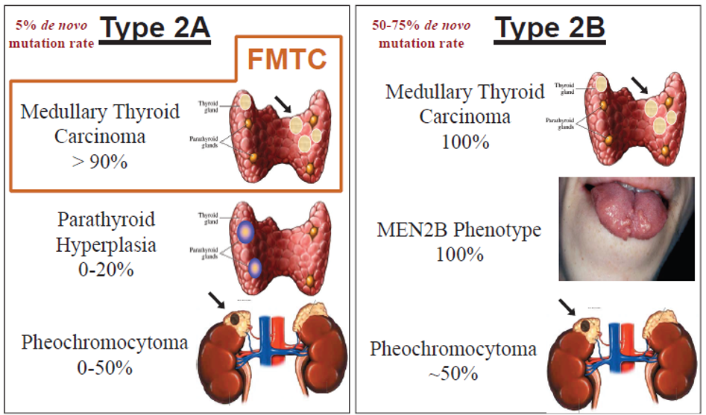
Multiple Endocrine Neoplasia type 2 (RET)
All Medullary thyroid cancer should have RET analysis
25% of all MTC are hereditary vs 75% sporadic, more often bilateral and multifocal
Cote, Gilbert
Notes:
-consider type 2A if two or more endocrine sites involved, consider if younger age
-type 2A usually presents with MTC by 35 years of age; can first present with pheochromocytoma, hyperparathyroidism at 38 years
-type 2B usually presents in childhood with death by age of 21 if not treated, and parathyroid disease is not seen
-clinical features of 2B: neuromas of lips, prominent lips, submucosal nodules, neuromas of eyelids, thickened corneal nerves, 75% Marfanoid appearance, 40% ganglioneuromas of GI tract
-age of onset in familial MTC is later than MEN2 and MEN2B, thought to be decreased penetrance of the pheochromocytoma

Slide 33
Genotype phenotype correlation
-rearranged during transfection (RET) receptor tyrosine kinase
-ATA risk stratification
All missense mutations, sequencing should detect
Waguespack, S. G. et al. (2011)

Slide 34
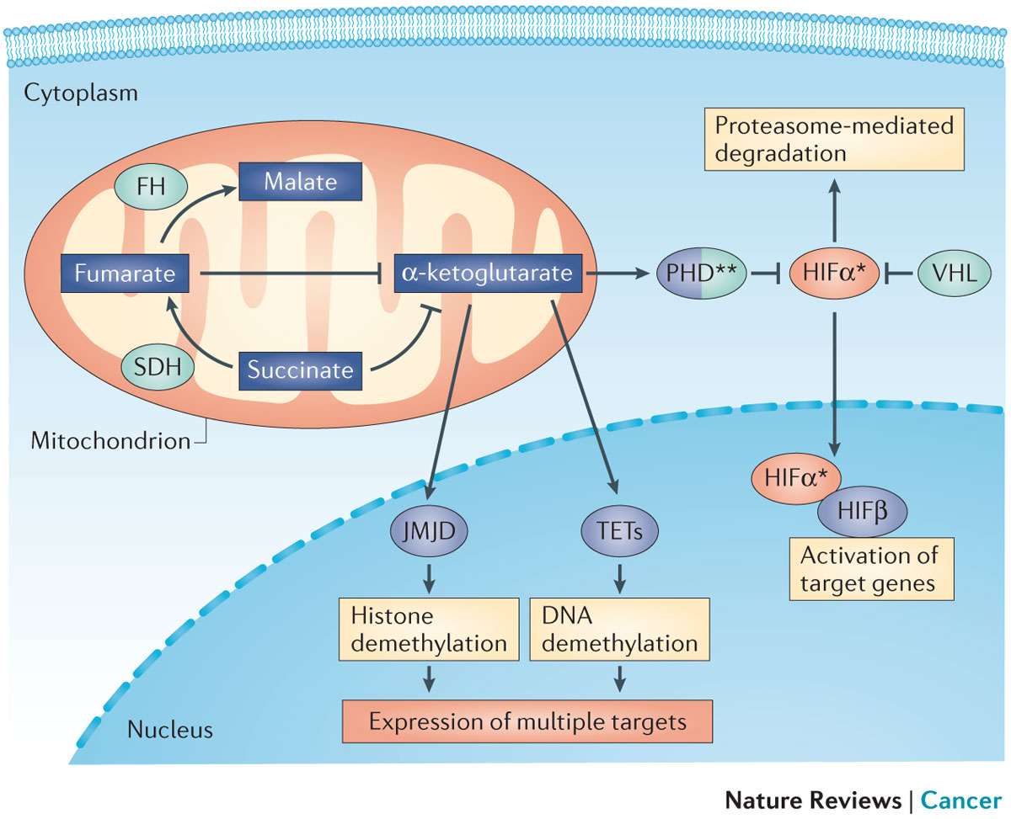
Isolated hereditary paraganglioma-pheochromocytoma
Dahia P et al. (2014)
Notes:
Non-syndromic, hereditary paraganglioma are caused by genes involved in the conversion of succinate to fumarate in the Krebs cycle. It is thought that inactivation of these genes result in a pseudohypoxic state causing activation of a number of genes through Jumonji (JMJ)-related histone demethylases (JMJDs), which demethylate histones; and the TET family of DNA hydroxylases (TETs)

Slide 35
Succinate dehydrogenase
Subunits
SDHA
SDHB
SDHC
SDHAF2 (assembly factor)
Some genotype, phenotype correlation
Norepinephrine, dopamine
SDHB high malignancy and recurrence risk
All pheochromocytoma and paraganglioma cases should have a genetics assessment

Slide 36
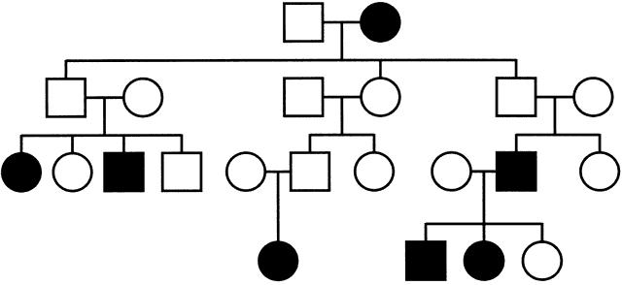
Succinate dehydrogenase D (maternally imprinted, paternally inherited)
Only individuals who inherit the mutation from their father are affected
If the mutation was inherited from the mother, they are not affected

Slide 37
Succinate dehydrogenase immunohistochemistry
Staining normal
Loss of staining/abnormal
Syndromic (MEN2, NF, VHL)
Non-syndromic (MAX, TMEM127)
Isolated (SDHA, SDHB, SDHC,
SDHD, SDHAF2)
Tischler AS et al. (2015)
Notes:
Staining for SDHB has been found to be specific for mutations in SDHx subunits, but the sensitivity is unknown. In addition other antibodies for SDHA and D have been developed also. However, staining can be helpful in pointing to the appropriate gene for molecular analysis.

Slide 38
Genetic Testing

Slide 39
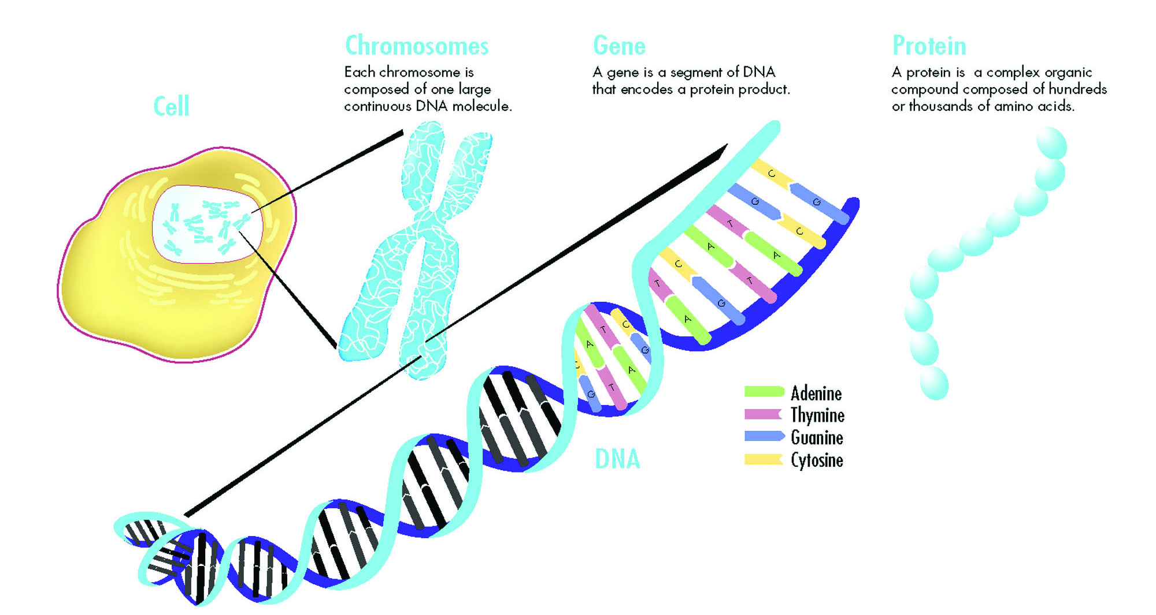
What to analyze: Chromosomes vs Genes -chromosome analysis does not analyze genes -most hereditary cancer syndromes are caused by gene mutations

Slide 40
Molecular genetic testing, know your alphabet!
Understanding the molecular genetic basis of a disease is critical in selecting the appropriate genetic test
There are a lot of laboratories offering different types of technologies
Many are conducted out of country, and require Ministry of Health of Ontario Approval
A normal genetic test $≠$ no mutation
Depending on when the genetic testing was done, could have a mutation (new gene found, new technique)

Slide 41
Select the individual to test -select the youngest living individual affected with cancer
CRC 75
MTC 65
Breast 70
PHEO 38

Slide 42
Select the gene to test
Straightforward disorders: one disorder, one gene
Von Hippel Lindau = VHL
Multiple endocrine neoplasia type 2: RET
Li Fraumeni Syndrome = TP53
Slightly more complicated: one disorder, more genes:
Lynch syndrome (5 genes): rely on immunohistochemistry of deficient protein
Cowden syndrome: test for more prevalent gene (e.g. PTEN, then PIK3CA, then AKT1)
Much more complicated: one tumour, many genes
Pheochromocytoma, paraganglioma

Slide 43
Structure of a gene
Mutations can occur anywhere and affect gene function
Some diseases have certain mutations which are more prevalent
The right technique needs to be chosen

Slide 44
What type of test do you need?
Full Gene sequencing ($1500)
When a single gene is suspected, but exact mutation is not known (first testing in a family)
Techniques: Sanger Sequencing
Single mutation analysis ($100)
A known mutation in a family or founder mutation in an ethnicity
Techniques: PCR amplification, allele specific oligonucleotides
Copy number variation ($1500)
When a whole exon of a gene is deleted and sequencing will read the other normal copy
Techniques: Multiplex-ligation probe ligation assay, array CGH
Triplet repeat expansion ($500)
Mutation is a repeat-type expansion not easily amplified by DNA polymerase
Techniques: Southern blot, quantitative PCR
Imprinted genes ($1500)
Gene is affected by methylation of the bases, not the sequence change
Techniques: Methylation-specific enzyme digestion

Slide 45
Which lab to choose?

Slide 46
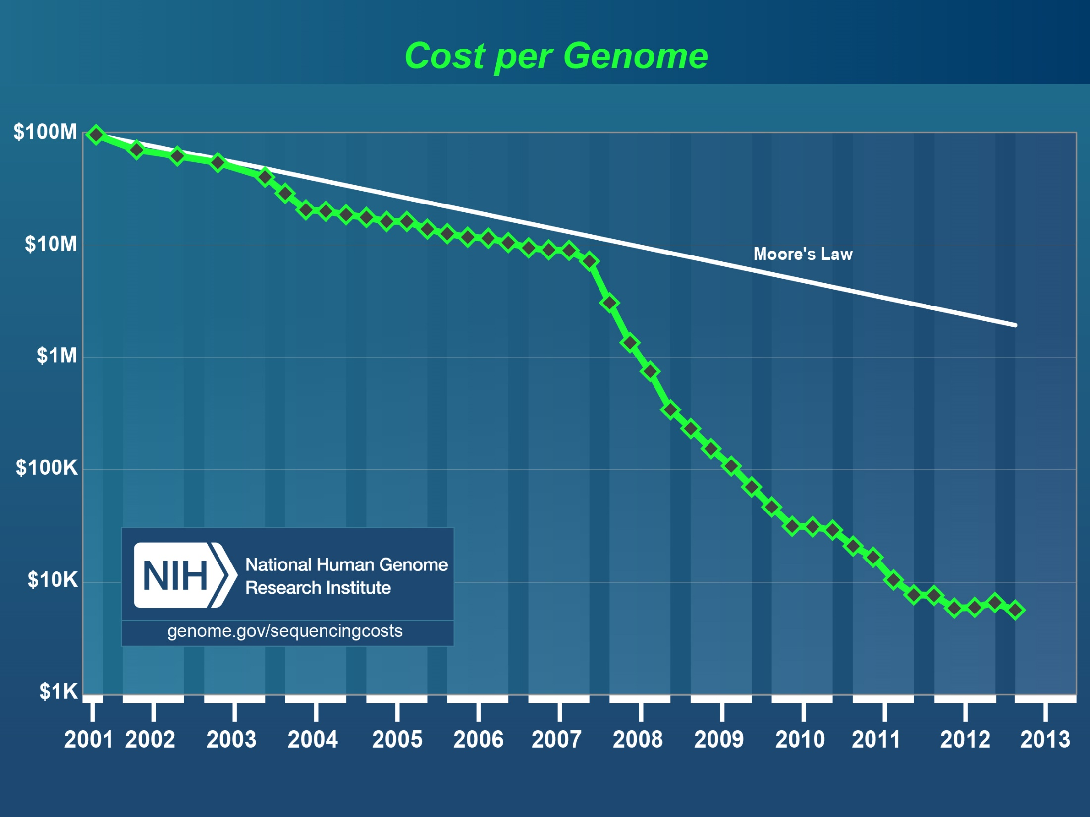
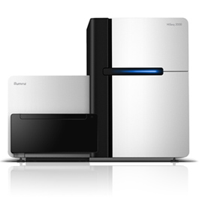
Notes:
It took over twenty years and 2.7 billion dollars to sequence the human genome back in 2005. Since then, next generation sequencing has come along and the price today for a full genome costs approximately $5000 and can be done in less than three months

Slide 47
Next generation sequencing, multiple genes concurrently
read depth
exon 1
exon 2
80bp
target
80bp
target
baits (120bp)
baits (120bp)

Slide 48
Interpretation of Genetic testing results
Maybe
Negative
Positive
Mutation is found
“have the gene”
Seen in other individuals with disorder
Surveillance decisions can be made
Genetic change is found
Not seen in other individuals with disorder
Significance uncertain
“Variant of uncertain significance”
Seen 30% during panel testing
Management decisions NOT made
Revisit the clinic
No genetic change is found
Limitation of the technology
May have another gene involved
Revisit the clinic, other gene testing

Slide 49
Genetic counselling
Informed consent for genetic testing
Genetic testing is different than other types of medical investigations
Implications on family members
Implications on insurance policies
Appropriate interpretation of results
Positive vs negative vs Variant of uncertain significance
Subsequent follow-up actions based on these results, eg surveillance
Family member cascade testing (asymptomatic positive → surveillance)
Prenatal genetics family planning
Some case examples…

Slide 50
Referral for ccRCC, “Robert”
43M diagnosed with a bilateral clear cell RCC five years ago
Has a negative family history
VHL genetic testing was conducted
A novel variant in the Von Hippel Lindau gene is found and called “Variant of uncertain significance”
Database search shows similar types of mutations in the same region in VHL pts
Further investigations show a cerebellar hemangioblastoma and pancreatic cysts
Patient is diagnosed with Von Hippel Lindau and the variant is deemed to be pathogenic after discussion with the laboratory

Slide 51
A call to the genetic counselor
Robert’s 18 year old daughter Mary is now pregnant and she has not shared this information with her yet
Expedited genetic testing on the familial mutation is conducted on Mary and she is referred to high risk obstetrics at Mount Sinai Hospital
Biochemical screening and imaging is requested on Mary
Mutational analysis confirms Mary is a carrier and asymptomatic
What about her baby?

Slide 53
A call to the genetic counselor
Prenatal chorionic villus sampling at 10 weeks is conducted and the baby is a carrier of the VHL variant
After a long discussion Mary decides to terminate the pregnancy
Mary is enrolled in surveillance

Slide 54
Two years later, when Mary is ready preimplantation genetic diagnosis…

Slide 55
A young breast cancer patient Charlotte
29 year old lady with ER/PR neg, Her2 positive breast cancer
Due to young age, gene panel is sent for genetic testing including:
BRCA1, BRCA2, TP53, CDH1, PTEN, STK11
Has a mutation in TP53, c.1010G>A; p.R337H
Diagnosed with Li-Fraumeni syndrome
Undergoes high risk surveillance
She comes in and asks for her 2 year old daughter Mary to get tested
Do you test the daughter?

Slide 56
Family testing in hereditary cancer
The identification of a mutation in the family allows that mutation to be tracked in asymptomatic individuals “Predictive Genetic testing”
This facilitates early initiation of surveillance on family members to detect and prevent cancer
So, do you test Charlotte’s daughter Mary?
Yes, Mary is at 50% risk (1st degree relative) of sharing the same mutation as Charlotte, and should have whole body MRI and surveillance for Li-Fraumeni syndrome

Slide 57
Family testing in hereditary cancer
Would your answer be different if Charlotte was diagnosed with a BRCA1 mutation?

Slide 58
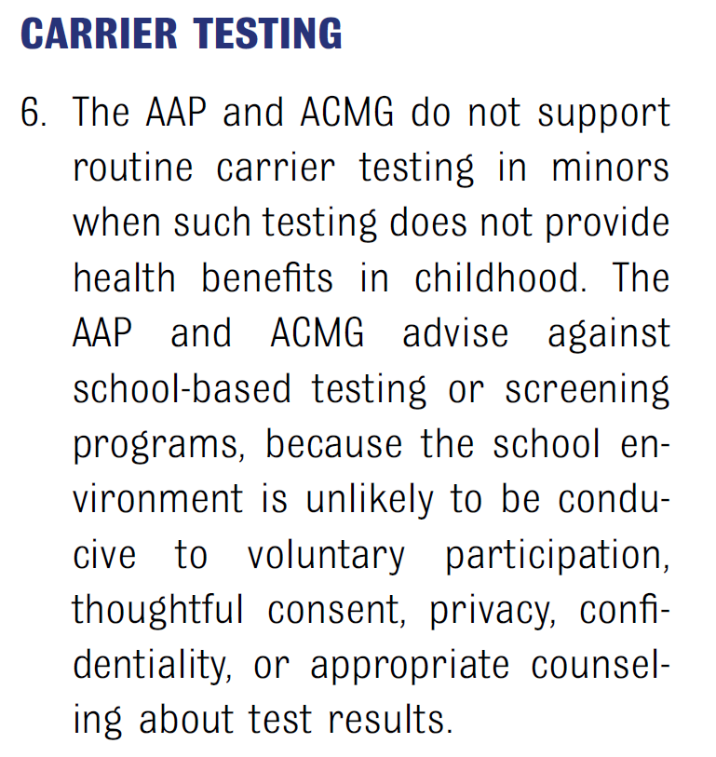
Family testing in hereditary cancer
Would your answer be different if Charlotte was diagnosed with a BRCA1 mutation?
Predictive genetic testing for BRCA1/BRCA2 is deferred until adulthood as there are no childhood manifestations
Unlike Li-Fraumeni (childhood manifestations)

Slide 59
Outline
Genetic terminology and concepts
Hereditary cancers
When to consider
Genetics assessment
Surveillance
Hereditary breast cancer syndromes
Hereditary colorectal cancer syndromes
Hereditary kidney cancer syndromes
Hereditary endocrine cancer syndromes
Genetic testing
Genetic counseling

Slide 61
raymond.kim@uhn.ca

